Slide 1

15CSE301 Computer Organization and Architecture
Lecture 2
Introduction: Revision topics
Dr Ganesh Neelakanta Iyer
Associate Professor, Dept of Computer Science and Engg
Amrita Vishwa Vidyapeetham, Coimbatore

Slide 2








About Me
Associate Professor, Amrita Vishwa Vidyapeetham
Masters & PhD from National University of Singapore (NUS)
Several years in Industry/Academia
Architect, Manager, Technology Evangelist, Visiting Faculty
Talks/workshops in USA, Europe, Australia, Asia
Cloud/Edge Computing, IoT, Software Engineering, Game Theory, Machine Learning
Kathakali Artist, Composer, Speaker, Traveler, Photographer
GANESHNIYER
http://ganeshniyer.com

Slide 3

Organization vs Architecture

Slide 4

Organization
Assume that I bought a car. I know how to drive it
It is enough to learn how to start it, how to shift gears and how to apply brakes etc. to drive a car, you do not need to learn how to repair if anything fails
Knowing how to drive a car is nothing but computer organization

Slide 5
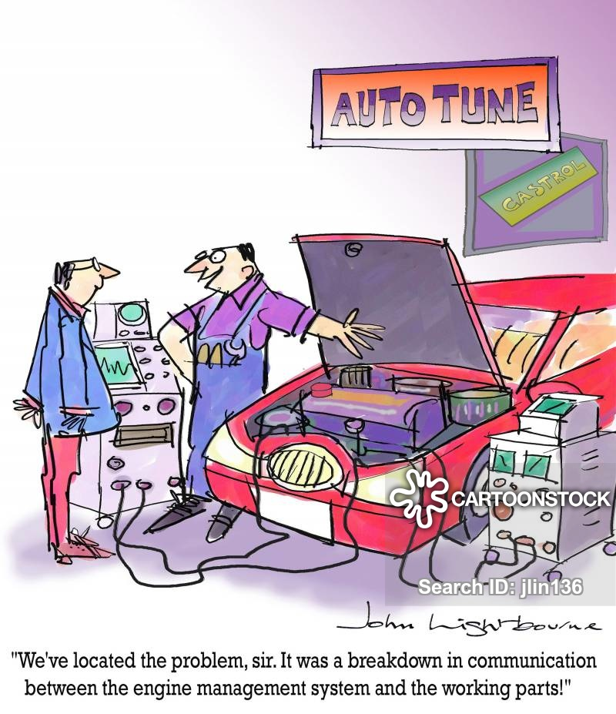
Architecture
If I have to repair my car then I should drive it to a mechanic because he would knows how it was manufactured and how to repair it
This is computer architecture

Slide 6
Computer Architecture is the “What” Computer Organization is the “How”
CA tells you what the system does
So, knowing about the architecture is basically knowing what functionalities will your system display
What you can expect to get out of it
CO tells you how exactly all units in your system have been arranged and interconnected to help realize the architectural goals your system claims to have achieved.
Which is why two systems from two different companies can provide the same functionalities to a user but one seems to be working better than the other or is more user friendly. That’s because despite the architectural similarities, there is a fundamental difference in it’s organization

Slide 7
Organization vs Architecture
Computer Architecture | Computer Organization
Computer Architecture is concerned with the way hardware components are connected together to form a computer system. | Computer Organization is concerned with the structure and behaviour of a computer system as seen by the user.
It acts as the interface between hardware and software. | It deals with the components of a connection in a system.
Computer Architecture helps us to understand the functionalities of a system. | Computer Organization tells us how exactly all the units in the system are arranged and interconnected.
A programmer can view architecture in terms of instructions, addressing modes and registers. | Whereas Organization expresses the realization of architecture.
While designing a computer system architecture is considered first. | An organization is done on the basis of architecture.
Computer Architecture deals with high-level design issues. | Computer Organization deals with low-level design issues.
Architecture involves Logic (Instruction sets, Addressing modes, Data types, Cache optimization) | Organization involves Physical Components (Circuit design, Adders, Signals, Peripherals)

Slide 8
Anatomy: Five components of any Computer (since 1946)
Personal Computer
Computer
Keyboard, Mouse
Processor
Memory
(where
programs,
data
live when
running)
Devices
Disk (where
programs,
data
live when
not running)
Control
(“brain”)
Input
Datapath
(“brawn”)
Output
Display, Printer
Notes:
That is, any computer, no matter how primitive or advance, can be divided into five parts:
1. The input devices bring the data from the outside world into the computer.
2. These data are kept in the computer’s memory until ...
3. The datapath request and process them.
4. The operation of the datapath is controlled by the computer’s controller.
All the work done by the computer will NOT do us any good unless we can get the data back to the outside world.
5. Getting the data back to the outside world is the job of the output devices.
The most COMMON way to connect these 5 components together is to use a network of busses.

Slide 9
Computer System Structure
Cache
CPU
CPU BUS
Bridge
Mem BUS
Memory
I/O BUS
Scsi/IDE
Adap
Lan
Adap
USB
Hub
Graphic
Adapt
Scsi Bus
Hard
Disk
LAN
KeyBoard
Mouse
Scanner
Video
Buffer

Slide 10
The Instruction Set: a Critical Interface
software
instruction set
hardware

Slide 11
Instruction Set Architecture (ISA)
Serves as an interface between software and hardware.
Provides a mechanism by which the software tells the hardware what should be done.
High level language code : C, C++, Java, Python,
compiler
Assembly language code: architecture specific statements
assembler
Machine language code: architecture specific bit patterns
software
instruction set
hardware

Slide 12
Interface Design
A good interface:
Lasts through many implementations (portability, compatability)
Is used in many different ways (generality)
Provides convenient functionality to higher levels
Permits an efficient implementation at lower levels
use
imp 1
time
Interface
use
imp 2
use
imp 3

Slide 13
Instruction Set Architecture
Assembly Language View
Processor state
Registers, memory, …
Instructions
addl, movl, leal, …
How instructions are encoded as bytes
Layer of Abstraction
Above: how to program machine
Processor executes instructions in a sequence
Below: what needs to be built
Use variety of tricks to make it run fast
E.g., execute multiple instructions simultaneously
Application
Program
Compiler
OS
ISA
CPU
Design
Circuit
Design
Chip
Layout

Slide 14
Levels of Representation
temp = v[k];
v[k] = v[k+1];
v[k+1] = temp;
High Level Language Program
Compiler
lw $15, 0($2)
lw $16, 4($2)
sw $16, 0($2)
sw $15, 4($2)
Assembly Language Program
Assembler
0000 1001 1100 0110 1010 1111 0101 1000
1010 1111 0101 1000 0000 1001 1100 0110
1100 0110 1010 1111 0101 1000 0000 1001
0101 1000 0000 1001 1100 0110 1010 1111
Machine Language Program
Machine Interpretation
Control Signal Specification
ALUOP[0:3] <= InstReg[9:11] & MASK
°
°

Slide 15
Levels of transformation
Programmable
Computer Specific
Manufacture Specific
C Instructions
Problems
Algorithms
Language (Program)
Assembly Language
Machine ISA Architecture
Machine
Microarchitecture
Circuits
Devices

Slide 16
ISA
ISA describes the design of a Computer in terms of the basic operations it must support
The ISA is not concerned with the implementation specific details of a computer
It is only concerned with the set or collection of basic operations the computer must support
For example the AMD Athlon and the Core 2 Duo processors have entirely different implementations but they support more or less the same set of basic operations as defined in the x86 Instruction Set

Slide 17
ISA
The ISA defines the types of instructions to be supported by the processor. Based on the type of operations they perform MIPS Instructions are classified into 3 types:
Arithmetic/Logic Instructions: These Instructions perform various Arithmetic & Logical operations on one or more operands.
Data Transfer Instructions: These instructions are responsible for the transfer of instructions from memory to the processor registers and vice versa.
Branch and Jump Instructions: These instructions are responsible for breaking the sequential flow of instructions and jumping to instructions at various other locations, this is necessary for the implementation of functions and conditional statements.

Slide 18
ISA
The computer ISA defines all of the programmer-visible components and operations of the computer
memory organization
address space -- how may locations can be addressed?
addressibility -- how many bits per location?
register set (a place to store a collection of bits)
how many? size? how are they used?
instruction set
Opcodes (operation selection codes)
data types (data types: byte or word)
addressing modes (coding schemes to access data)
ISA provides all information needed for someone that wants to write a program in machine language (or translate from a high-level language to machine language)

Slide 19
Instruction Set Design Issues
Instruction set design issues include:
Where are operands stored?
registers, memory, stack, accumulator
How many explicit operands are there?
0, 1, 2, or 3
How is the operand location specified?
register, immediate, indirect, . . .
What type & size of operands are supported?
byte, int, float, double, string, vector. . .
What operations are supported?
add, sub, mul, move, compare . . .

Slide 20
Evolution of Instruction Sets
Single Accumulator (EDSAC 1950, Maurice Wilkes)
Accumulator + Index Registers
(Manchester Mark I, IBM 700 series 1953)
Separation of Programming Model
from Implementation
High-level Language Based
Concept of a Family
(B5000 1963)
(IBM 360 1964)
General Purpose Register Machines
Complex Instruction Sets
Load/Store Architecture
(Vax, Intel 432 1977-80)
(CDC 6600, Cray 1 1963-76)
CISC
RISC
Intel x86, Pentium
(MIPS,Sparc,HP-PA,IBM RS6000,PowerPC . . .1987)

Slide 21
Classifying ISAs
Accumulator (before 1960, e.g. 68HC11):
1-address add A acc ← acc + mem[A]
Stack (1960s to 1970s):
0-address add tos ← tos + next
Memory-Memory (1970s to 1980s):
2-address add A, B mem[A] ← mem[A] + mem[B]
3-address add A, B, C mem[A] ← mem[B] + mem[C]
Register-Memory (1970s to present, e.g. 80x86):
2-address add R1, A R1 ← R1 + mem[A]
load R1, A R1 ← mem[A]
Register-Register (Load/Store) (1960s to present, e.g. MIPS):
3-address add R1, R2, R3 R1 ← R2 + R3
load R1, R2 R1 ← mem[R2]
store R1, R2 mem[R1] ← R2

Slide 22
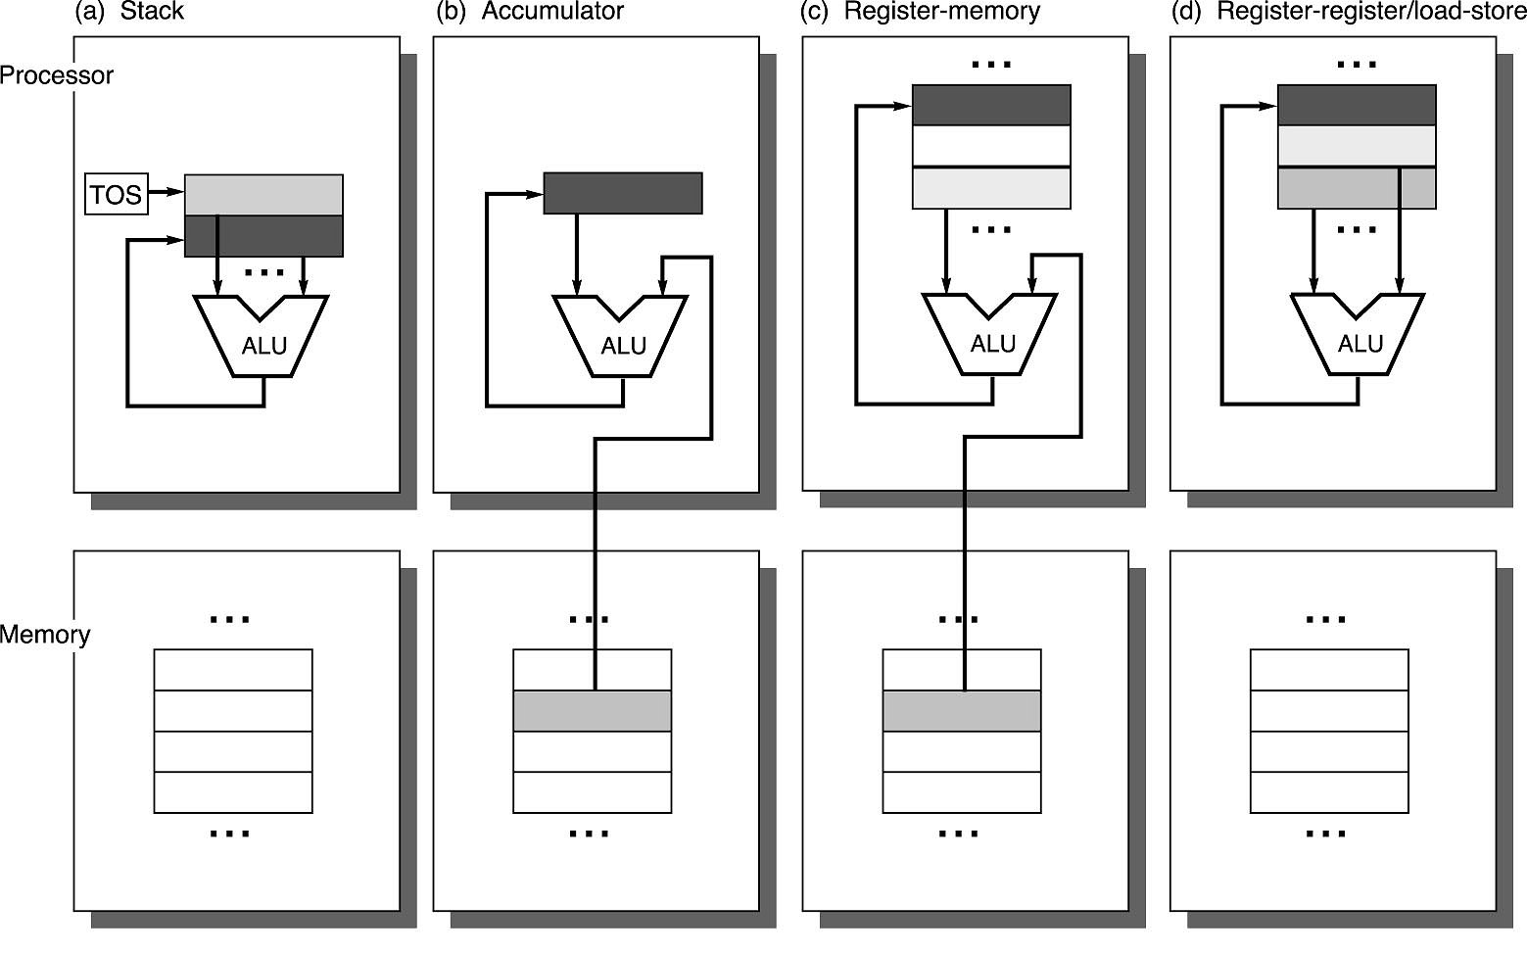
Operand Locations in Four ISA Classes
GPR

Slide 23
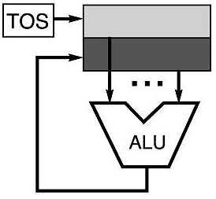
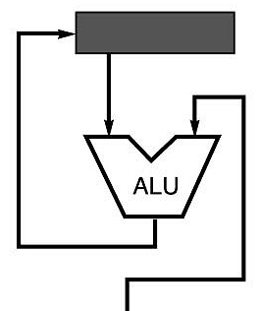
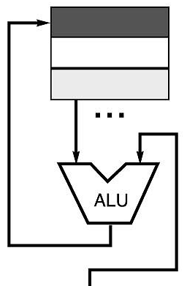
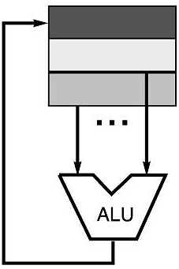
Code Sequence C = A + B for Four Instruction Sets
Stack | Accumulator | Register (register-memory) | Register (load-store)
Push A Push B Add Pop C | Load A Add B Store C | Load R1, A Add R1, B Store C, R1 | Load R1,A Load R2, B Add R3, R1, R2 Store C, R3
memory
memory
acc = acc + mem[C]
R1 = R1 + mem[C]
R3 = R1 + R2

Slide 24
More About General Purpose Registers
Why do almost all new architectures use GPRs?
Registers are much faster than memory (even cache)
Register values are available immediately
When memory isn’t ready, processor must wait (“stall”)
Registers are convenient for variable storage
Compiler assigns some variables just to registers
More compact code since small fields specify registers (compared to memory addresses)
Processor
Memory
Disk
Registers
Cache

Slide 25
Stack Architectures
Instruction set:
add, sub, mult, div, . . .
push A, pop A
Example: A*B - (A+C*B)
push A
push B
mul
push A
push C
push B
mul
add
sub
A
B
A*B
A
C
B
B*C
A+B*C
result
A
A*B
A
C
A
A*B
A*B
A
A*B
A*B

Slide 26
Stacks: Pros and Cons
Pros
Good code density (implicit top of stack)
Low hardware requirements
Easy to write a simpler compiler for stack architectures
Cons
Stack becomes the bottleneck
Little ability for parallelism or pipelining
Data is not always at the top of stack when need, so additional instructions like TOP and SWAP are needed
Difficult to write an optimizing compiler for stack architectures

Slide 27
Accumulator Architectures
Instruction set:
add A, sub A, mult A, div A, . . .
load A, store A
Example: A*B - (A+C*B)
load B
mul C
add A
store D
load A
mul B
sub D
acc = acc +,-,*,/ mem[A]
B
B*C
A+B*C
A+B*C
A
A*B
result

Slide 28
Accumulators: Pros and Cons
Pros
Very low hardware requirements
Easy to design and understand
Cons
Accumulator becomes the bottleneck
Little ability for parallelism or pipelining
High memory traffic

Slide 29
Memory-Memory Architectures
Instruction set:
(3 operands) add A, B, C sub A, B, C mul A, B, C
(2 operands) add A, B sub A, B mul A, B
Example: A*B - (A+C*B)
3 operands 2 operands
mul D, A, B mov D, A
mul E, C, B mul D, B
add E, A, E mov E, C
sub E, D, E mul E, B
add E, A
sub E, D

Slide 30
Memory-Memory: Pros and Cons
Pros
Requires fewer instructions (especially if 3 operands)
Easy to write compilers for (especially if 3 operands)
Cons
Very high memory traffic (especially if 3 operands)
Variable number of clocks per instruction
With two operands, more data movements are required

Slide 31
Register-Memory Architectures
Instruction set:
add R1, A sub R1, A mul R1, B
load R1, A store R1, A
Example: A*B - (A+C*B)
load R1, A
mul R1, B /* A*B */
store R1, D
load R2, C
mul R2, B /* C*B */
add R2, A /* A + CB */
sub R2, D /* AB - (A + C*B) */
R1 = R1 +,-,*,/ mem[B]

Slide 32
Memory-Register: Pros and Cons
Pros
Some data can be accessed without loading first
Instruction format easy to encode
Good code density
Cons
Operands are not equivalent (poor orthogonal)
Variable number of clocks per instruction
May limit number of registers

Slide 33
Load-Store Architectures
Instruction set:
add R1, R2, R3 sub R1, R2, R3 mul R1, R2, R3
load R1, &A store R1, &A move R1, R2
Example: A*B - (A+C*B)
load R1, &A
load R2, &B
load R3, &C
mul R7, R3, R2 /* C*B */
add R8, R7, R1 /* A + C*B */
mul R9, R1, R2 /* A*B */
sub R10, R9, R8 /* A*B - (A+C*B) */
R3 = R1 +,-,*,/ R2

Slide 34
Load-Store: Pros and Cons
Pros
Simple, fixed length instruction encodings
Instructions take similar number of cycles
Relatively easy to pipeline and make superscalar
Cons
Higher instruction count
Not all instructions need three operands
Dependent on good compiler

Slide 35
Registers: Advantages and Disadvantages
Advantages
Faster than cache or main memory (no addressing mode or tags)
Deterministic (no misses)
Can replicate (multiple read ports)
Short identifier (typically 3 to 8 bits)
Reduce memory traffic
Disadvantages
Need to save and restore on procedure calls and context switch
Can’t take the address of a register (for pointers)
Fixed size (can’t store strings or structures efficiently)
Compiler must manage
Limited number
Every ISA designed after 1980 uses a load-store ISA (i.e RISC, to simplify CPU design).

Slide 36
Self-Practice Compute f=(a-b)/(c-d*e) using various ISA Architectures

Slide 37

RECAP: Instruction Execution Cycle
Desserts at Copenhagen

Slide 38
Key words
Instruction
Command given by user to computer
Execution
Process by which computer performs instruction
Instruction Execution
A program to be executed by a processor consists of a set of instructions stored in memory
Program Counter
Register in a computer processor that contains the address of the next instruction which will be executed
Memory Address Register (MAR)
holds the Memory Location of data that needs to be accessed

Slide 39
Key words
Instruction Register (IR)
part of CPU control unit that stores the instruction currently being executed or decoded
Memory Buffer Register (MBR)
stores the data being transferred to and from immediate access store also known as Memory Data Register (MDR)
Instruction Register(IR)
Holds the last instruction fetched

Slide 40
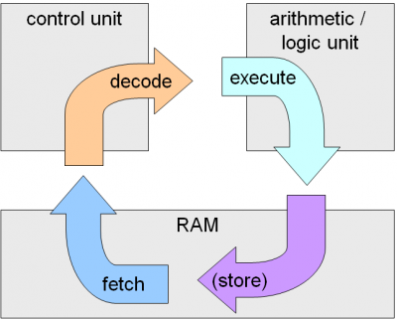
The instruction cycle
This is a process of getting the instruction from the memory, decoding it to the machine language and executing it. So, three basic steps of the cycle are:
Fetch the instruction
Decode it
Execute
The whole process of fetching the instructions from the memory, decoding it to the machine language and executing it, is termed as a instruction cycle

Slide 41
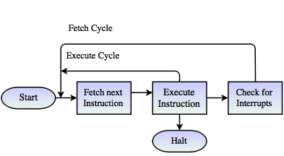
The instruction cycle
Step1: Fetch
In this step the instructions are fetched from the memory and are put into the instruction register
The instructions are decoded to the machine language
Gets the accurate address from the memory in case it is not correct
Step2: Execute
It simply executes the instructions

Slide 42
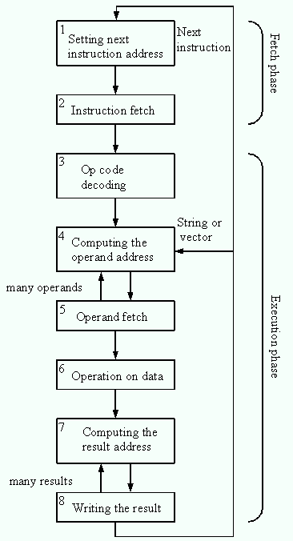
The instruction cycle
The phases, which belong to the instruction execution cycle last time intervals, which are determined by timing signals coming from the clock
In each phase, the control signal generator provides signals, which stimulate appropriate operations
It is done by opening information transfer paths (e.g. busses) and activating desired operations in executive units (e.g. ALU - addition/subtraction, program counter increment, et similar)

Slide 43

Little Endian vs Big Endian
Lunch @ Boston

Slide 44
Big Endian vs. Little Endian
Most memories are byte-addressable
Data stored by the byte
But the word size of most CPU’s is a word, which occupies multiple bytes (e.g., 32 bit word is 4 bytes)
Alignment problem: may need multiple memory accesses to retrieve an odd address (unaligned access) vs. even address (aligned access)
Two ways to store multi-byte data
Big Endian: Store most significant bytes first (not bits!)
Little Endian: Store least significant bytes first

Slide 45
Endian Byte Order
E.g. given 12345678 in hex to store
Big Endian
Byte 0: 12
Byte 1: 34
Byte 2: 56
Byte 3: 78
Little Endian
Byte 0: 78
Byte 1: 56
Byte 2: 34
Byte 3: 12
Note: This is the internal storage format, usually invisible to the user

Slide 46
Standard…What Standard?
Intel (80x86), VAX are little-endian
IBM 370, Motorola 680x0 (Mac), and most RISC systems are big-endian
Makes it problematic to translate data back and forth between say a Mac/PC
Internet is big-endian
Why? Useful control bits in the Most Significant Byte can be processed as the data streams in to avoid processing the rest of the data
Makes writing Internet programs on PC more awkward!
Must convert back and forth
Notes:
30

Slide 47
Little-Endian vs. Big-Endian Representation
A0 B1 C2 D3 E4 F5 67 89₁₆
MSB
LSB
Big-Endian
Little-Endian
0
MSB = A0
LSB = 89
B1
67
C2
F5
D3
E4
address
E4
D3
F5
C2
67
B1
LSB = 89
MSB = A0
MAX

Slide 48
Little-Endian vs. Big-Endian Camps
0
MSB
LSB
. . .
. . .
address
LSB
MSB
MAX
Big-Endian
Little-Endian
Motorola 68xx, 680x0
Bi-Endian
Intel
IBM
AMD
Motorola Power PC
Hewlett-Packard
Silicon Graphics MIPS
DEC VAX
Sun SuperSPARC
RS 232
Internet TCP/IP

Slide 49

RISC vs CISC

Slide 50
CISC- Complex Instruction Set Computer
Memory in those days was expensive
bigger program->more storage->more money
Hence needed to reduce the number of instructions per program
Number of instructions are reduced by having multiple operations within a single instruction
Multiple operations lead to many different kinds of instructions that access memory
In turn making instruction length variable and fetch-decode-execute time unpredictable – making it more complex
Thus hardware handles the complexity
Example: x86 ISA

Slide 51
RISC
Attempt to make architecture simpler
Reduced number of instructions
Make them all the same format if poss.
Reduce the number of memory accesses required by increasing the number of registers
Reduce the number of addressing modes
Allow pipelining of instructions

Slide 52
RISC
The characteristics of most RISC processors are…
A large number of GP registers
A small number of simple instructions that mostly have the same format
A minimal number of addressing modes
Optimisation of instruction pipeline

Slide 53
Reduced Instruction Set Computer
MIPS = Reduced Instruction Set Computer (RlSC)
≈ 200 instructions, 32 bits each, 3 formats
all operands in registers
almost all are 32 bits each
≈ 1 addressing mode: Mem[reg + imm]
x86 = Complex Instruction Set Computer (ClSC)
> 1000 instructions, 1 to 15 bytes each
operands in dedicated registers, general purpose registers, memory, on stack, …
can be 1, 2, 4, 8 bytes, signed or unsigned
10s of addressing modes
e.g. Mem[segment + reg + reg*scale + offset]
Notes:
DEC PDP-8 has about 8 insructions

Slide 54
Example: MUL instruction
CISC
RISC
This instruction takes two inputs: the memory location of the two numbers to multiply, it then performs the multiplication and stores the result in the first memory location
MUL 1200, 1201
Where MUL takes the value from either two memory locations (say 1200 and 1201) or two registers, finds their product and stores the result in location 1200
Since in a CISC style instruction, the CPU has to do more work in a single instruction, so clock speeds are slightly slower
Number of general purpose registers are less as more transistors need to be used to decode the instructions.
We have to first load the data from the memory using the LOAD instruction, then multiply the numbers, and the store the result in the memory.
Load A, 1200
Load B, 1201
Mul A, B
Store 1200, A
Here the Load instruction stores the data from a memory location like 1200 into a register A or B
Mul multiplies values in the two registers stores it in A
Then finally we store the value of A in 1200 (or any other memory location)
In RISC architectures, operations are allowed only on Registers and not directly on the memory

Slide 55
CISC vs RISC
Architectural Characteristics | Complex Instruction Set Computer(CISC) | Reduced Instruction Set Computer(RISC)
Instruction size and format | Large set of instructions with variable formats (16-64 bits per instruction). | Small set of instructions with fixed format (32 bit).
Data transfer | Memory to memory. | Register to register.
CPU control | Most micro coded using control memory (ROM) but modern CISC use hardwired control. | Mostly hardwired without control memory.
Instruction type | Not register based instructions. | Register based instructions.
Memory access | More memory access. | Less memory access.
Clocks | Includes multi-clocks. | Includes single clock.
Instruction nature | Instructions are complex. | Instructions are reduced and simple.
Example | INTEL | MIPS, IBM

Slide 56

Processor Architecture based on memory usage
Palace of Versailles @ Paris

Slide 57
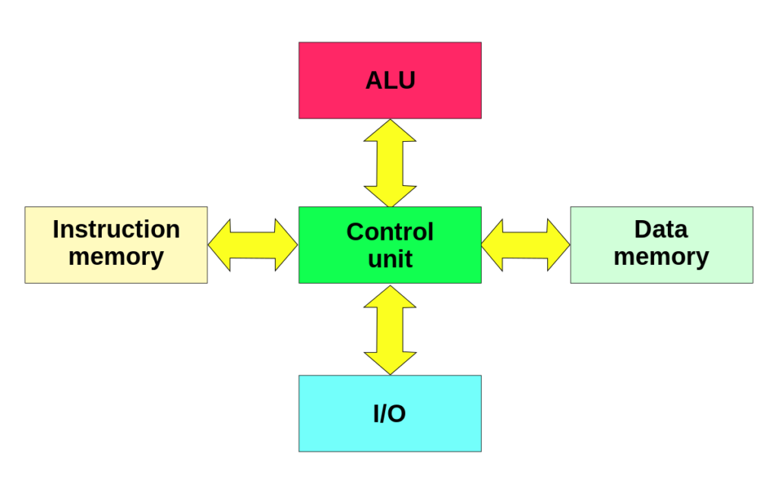
Harvard Architecture
The Harvard architecture stores machine instructions and data in separate memory units that are connected by different busses
In this case, there are at least two memory address spaces to work with, so there is a memory register for machine instructions and another memory register for data
Computers designed with the Harvard architecture are able to run a program and access data independently, and therefore simultaneously
Harvard architecture has a strict separation between data and code.

Slide 58
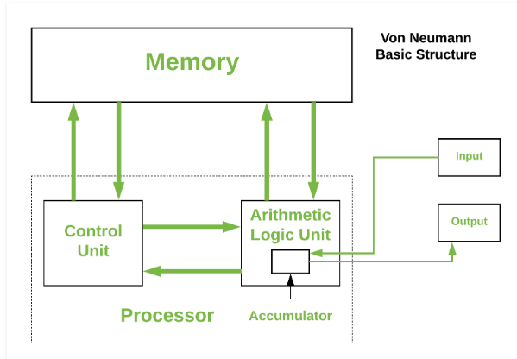
Von Neumann Architecture
Von Neumann architecture is based on the stored-program computer concept, where instruction data and program data are stored in the same memory
It has only one bus which is used for both data transfers and instruction fetches, and therefore data transfers and instruction fetches must be scheduled - they can not be performed at the same time.

Slide 59
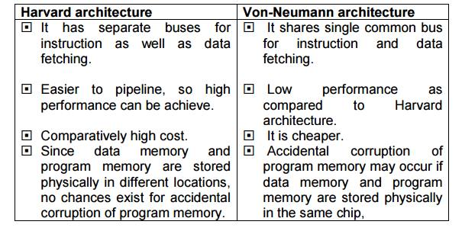
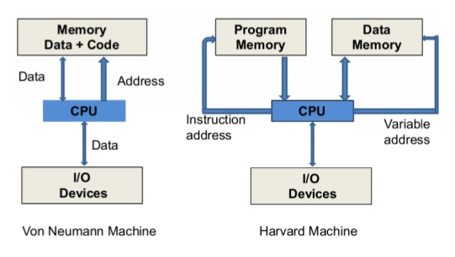
Differences

Slide 60

Addressing Modes
Singapore

Slide 61
Addressing Modes
Immediate addressing mode
In this mode data is present in address field of instruction
Direct (Absolute) addressing
The operand’s offset is given in the instruction as an 8 bit or 16 bit displacement element
Designed like one address instruction format
Example: MOV AL, 35H (move the data 35H into AL register)
Example: ADD AL,[0301] //add the contents of offset address 0301 to AL
In this addressing mode the 16 bit effective address of the data is the part of the instruction
Indirect addressing Mode
In this mode address field of instruction contains the address of effective address.
Indexed: Example: MOV AX, [SI +05]
Based Indexed: Example: ADD AX, [BX+SI]
Here two references are required - 1st reference to get effective address; 2nd reference to access the data

Slide 62
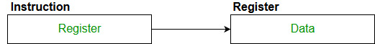
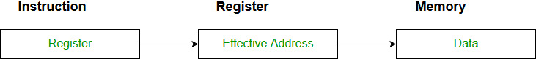
Addressing Modes
Register Mode
In register addressing the operand is placed in one of 8 bit or 16 bit general purpose registers
Here one register reference is required to access the data
The data is in the register that is specified by the instruction
MOV AX,CX (move the contents of CX register to AX register)
Register Indirect mode
In this addressing the operand’s offset is placed in any one of the registers BX,BP,SI,DI as specified in the instruction
The effective address of the data is in the base register or an index register that is specified by the instruction
MOV AX, [BX](move the contents of memory location s addressed by the register BX to the register AX)

Slide 63
Office Hours
Monday 1120-1210 @ My office

